Slide 1
Forgery Detection using
Neural Networks
Sangseok Lee
Shota Takeshima
Jaryl Ngan

Slide 2
Objectives
Highlight the importance of forgery detection
Discuss the types of forgery methods
Introduce traditional and current detection techniques
Show the results of some of the models that we reproduced
Assess their performance
Identify challenges and limitations
Notes:
In this presentation, we will first attempt to highlight the importance of forgery detection. Next, we will discuss the types of common forgery techniques being used. Then, we will introduce traditional and current detection techniques. Next, we show the results of some of the models that we reproduced. Finally, we will assess the performance of these models and identify the challenges and limitations of the models and forgery detection as a whole.

Slide 3
Why is forgery detection important?
Viral spread of fakes news on social media
Quality of manipulated images has grown tremendously through deep learning techniques, making differentiate between genuine and fake difficult
Many possible threats
Putting into doubt images and videos as sources of evidence
Notes:
Fakes news has existed for centuries. However, the rise of social media has resulted in fake news being spread far and wide. Fake news or allegations of fake news are not everywhere. Differentiating between authentic and fake news is often non-trivial, however this task has been made harder with the advent of fake images and videos generated by digital manipulation, in particular, involving facial information. Forgery techniques have gotten so advanced that for a majority of the population it is virtually impossible for them to distinguish between real and fake. These facial manipulation techniques utilize deep learning methods to change the expression on a person’s face or even swap the face of one person on to the face of another person. Malicious actors can easily get access to this technology and commit nefarious acts. Some potential threats include fake videos of world leaders making callous comments or company executives releasing information which could send shock waves to the equity markets. The possibilities for abuse are wide-ranging.

Slide 4
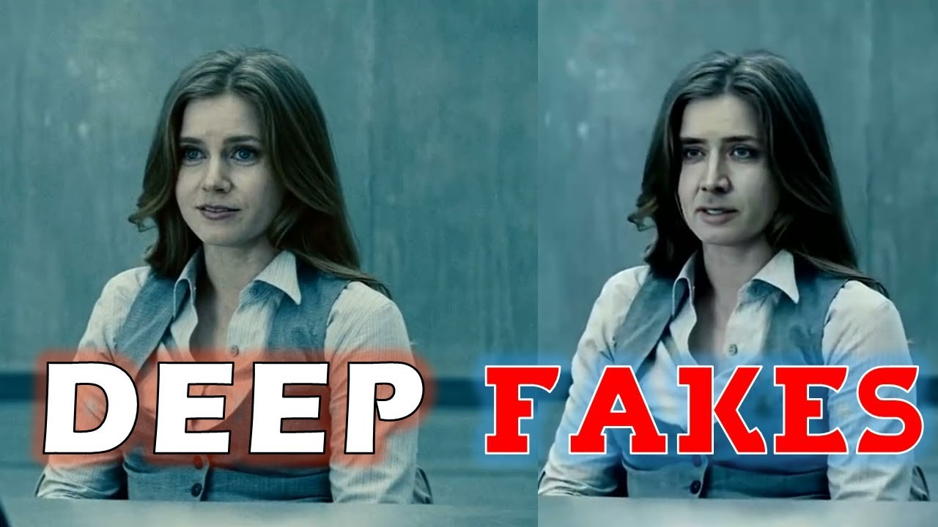
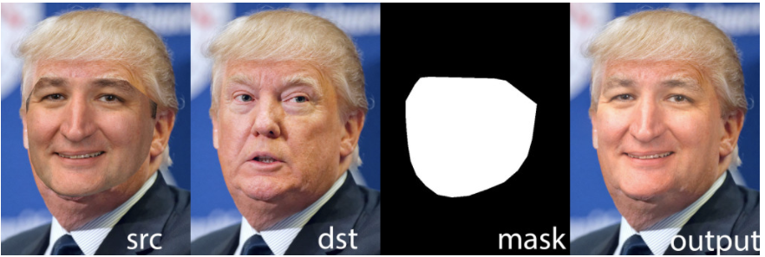
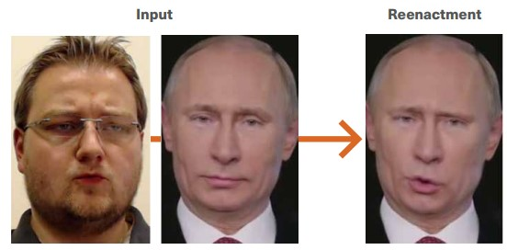
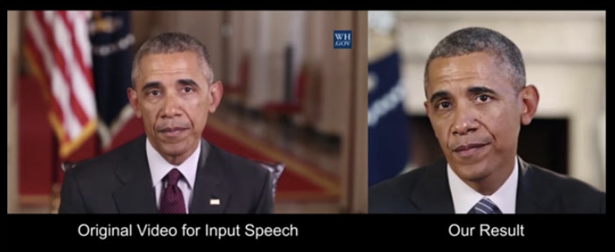
Common Forgery Techniques
Figure 1: Faceswapping Ted Cruz’s face to fit Donald Trump
Figure 2: Nicholas Cage DeepFakes with Amy Adams using FakeApp
Figure 3: Vladimir Putin pouting using Face2Face
Figure 4: Changing Obama's Expressions using NeuralTextures
Notes:
Most manipulation techniques fall under two broad categories. The first is identity swapping and the second is facial reenactment. Identity Swapping involves generating a video of the target with the faces replaced by synthesized faces of the source while keeping the same facial expressions. Facial reenactments allow the source to change the target expressions while preserving the identity of the target.
FaceSwap in Figure 1 is an identity swapping technique which transfers the facial region from one image to another. It extracts the facial region by detecting facial landmarks. A 3-D model is then fitted. Using this model, the extracted facial region is projected onto the target image. This is optimized by minimizing the distance between the localized landmarks and the project shape based on the input image. Finally, the rendered model is blended with the target image.
DeepFakes has become a term widely synonymous with fake facial images, however it is also a specific identity swapping technique. There are various public implementations of DeepFakes available, most notably FakeApp. The method uses two autoencoders with one encoder shared between the source and target images. To create a fake image, the trained encoder and decoder of the source face are applied to the target face
Face2Face is a facial reenactment technique. The method used two video input streams. Manually selected frames are used to generate a dense reconstruction of the facial images which is then capable of synthesizing the face with different expressions.
NeuralTextures is another facial reenactment method. It is uses a Generative Adversarial Network-based facial to learn from the original image data a neural texture for the target person. [3] The model uses two loss functions, the first is the photo-metric reconstruction loss and the other is an adversarial loss. Neural textures has the ability to change facial expressions of any facial region, however we concentrate this study to only the mouth region as there is insufficient input the modify the other regions.

Slide 5
Traditional Forgery Detection Techniques
Fingerprints from capturing methods
Highly specific and not robust in unseen conditions
Social Media platforms edit these fingerprints through compression techniques rendering many traditional techniques uneffective
Not scalable
Notes:
Traditionally, media forensics methods were based on factors such as fingerprints from the capturing device and the editing software. However, most of these features are highly specific and are therefore not robust in different conditions. Nowadays, when media is shared on social media platforms, most of these platforms automatically modify the media through compression and other types of operations, rendering many of the traditional techniques useless. Although digital forensics experts can still analyze videos for evidence of manipulation, reviewing the droves of information online is impossible.

Slide 6
Deep Learning Detection Techniques
Leverage Machine Learning and Computer Vision
Convolutional Neural Networks
Autoencoders
Long-short term Memory Networks
Steganalysis
Notes:
It is therefore necessary to leverage machine learning models with computer vision to create scalable detection methods. However, these models require huge amounts of training data and computation power. Fortunately, over the past few years, interest in this area has been growing rapidly and cloud computation resources have also expanded. Many new datasets have been collected and released to the public, with each release being much bigger than the previous ones. Faceforensics, Celeb-df and DeepFake Detection Challenge (DFDC) dataset just to name a few.
Researchers applying deep learning in the media forensic field have achieved great success. Convolutional neural networks (CNN) applied with median filtering has been effective. Others have used CNNs to detect swapped faces.
Autoencoders is another tool used in forgery detection tasks. A stacked autoencoder was used to learn complex features for each individual image patch, and then integrated the contextual information of each patch to perform the final results. Autoencoders can also sieve out implicit information from noisy data, allowing for better anomaly detection.
Long short-term memory (LSTM) network has been another tool applied in this field. Two researchers utilized a hybrid of CNNs and LSTM which was able to detect areas in the images that were altered.
Development in employing steganalysis rich models (SRM) has also been notable. Noisy features are filtered out using SRM filters. The remaining features are then fed in the CNN.

Slide 7
Data and Preprocessing
Faceforensics++ Dataset, 1000 videos from youtube
Deepfakes and Neural Textures manipulations performed on the 1000 videos with c40 compression
Created two datasets, each with 2000 videos, 1000 being original and the other 1000 manipulated by either Deepfakes or Neural Textures
Videos split into images
Faces are extracted using Multi-task Cascaded Convolutional Networks (MTCNN)
Notes:
In this project, we use the FaceForensics++ dataset [1] of pristine and manipulated videos. The dataset consists of 1000 original videos from YouTube. We apply two manipulation methods resulting in a total of 2000 manipulated videos. The two methods which were earlier discussed are DeepFakes and Neural Textures. In addition, these 3000 videos are formatted into three different compression rates: raw (uncompressed), c23 (medium compression), c40 (high compression). In this paper, we focus on c40 for two main reasons. First, existing literature has indicated that facial forgery detection becomes more difficult when the video quality is lower. Second, due to the lack of storage and computing resources, it was not feasible to include the other video qualities.
Two datasets were used, one contains the original and DeepFake manipulated videos and the other contains the original and Neural Textures manipulated videos. Each of the datasets therefore contains 2000 videos, with 1000 being original and the other 1000 being manipulated. The videos were then cut by frames, with 10 frames from each video so that the input data would be images instead of videos.
We extracted faces from all the frames using Multi-task Cascaded Convolutional Networks which is a state-of-the-art techniques.

Slide 8
Models
Resnet-18
Common Convolutional Architecture used as baseline model
Pre-trained on ImageNet
Xception
Extension of the Inception architecture
Inception Resnet V1
Hybrid Inception version that has a similar computational cost to Inception-v3
Performs higher accuracies at a lower epoch.
Pre-trained on the VGGFace2 dataset, which is focusing on facial recognition.
Notes:
Ultimately, we decided to compare the following three models: Resnet-18, Xception and Inception Resnet V1.
Resnet-18 utilizes a common convolutional architecture, we therefore use it as the baseline model. This model was pre-trained on ImageNet, a dataset that contains of over 15 million labeled high-resolution images in over 22,000 categories. We then fine-tuned this model by training it on our data.
Introduced by Google, Xception stands for Extreme version of Inception-v3 [7]. Xception is an extension of the Inception architecture which replaces the standard Inception modules with depthwise separable convolutions. The Xception architecture has 36 convolutional layers forming the feature extraction base of the network.
Inspired by the performance of the ResNet, a hybrid inception module was proposed. Empirical research has shown that Inception-ResNet model is able to achieve higher accuracies at a lower epoch. We use a Inception Resnet V1 model pretrained on the VGGFace2 dataset[9], instead of Imagenet that we used for Resnet-18. We made this choice as the VGGFace2 dataset is more widely used for facial recognition tasks. Since our objective was to detect facial image forgeries, it seems like a reasonable choice.

Slide 9
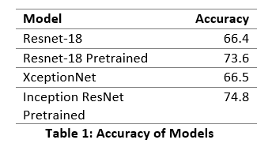
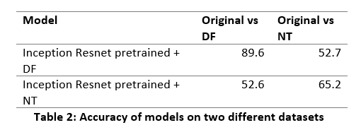
Results/ Evaluation
Accuracy results based on the test set of c40 compressed Neural Texture manipulated images
Transfer learning improves the performance
NeuralTextures is more challenging to detect than Deepfakes
Not robust to unseen manipulation techniques
Notes:
The first table summarizes the accuracy results on the test set for various models trained on the full Faceforensics dataset. The accuracy scores given are for classifying original and NeuralTextures frames at the highest compression level (c40). To avoid overfitting and poor generalization, pretrained models were used. The Resnet Model is pretrained on ImageNet classification. Inception Resnet V1 is pretrained on VGGFace2 face recognition. Transfer learning improves the performance significantly, especially when the model is pre-trained for facial recognition tasks.
We trained our models on highly compressed c40 NeuralTextures and DeepFakes videos and cross-tested both datasets to check the generalizability of the models on unseen manipulation techniques. Table 2 shows the accuracy percentages of the Inception ResNet Model trained and tested on both datasets. The models performed well with 89.6\% accuracy on the DeepFakes dataset and 65.2\% on the NeuralTextures dataset. These results were achieved in a relatively short training time but were able to outperform humans significantly. These models would likely benefit from more computation resources. It is also important to note that the models were able to detect forgeries made by DeepFakes much better than forgeries made by NeuralTextures. This result is consistent with human performance as humans are able to detect DeepFakes better. Neural Textures make only slight amendments to the expression of the target, making it harder to detect. However, the models did not perform well when it was exposed to manipulation methods they were not trained on. The model trained with the DeepFakes dataset only achieved a 52.7\% accuracy when evaluated on the test set of the Neural Textures dataset. Whereas, the model trained with the Neural Textures dataset only achieved a 52.6\% when evaluated on the test set of the DeepFakes dataset. Both models performed only slightly better than random chance when exposed to an unseen manipulation technique.

Slide 10
Concluding Remarks
Outperforms humans
Deep learning is vital for the forensics field
Poor performance on unseen manipulation techniques
Possible futurework
Examine uncompressed and moderately compressed videos
Examine other manipulation techniques
Examine other models
Notes:
In this paper, we found that deep learning models performed well, much better than humans and much more scalable. Going forward, utilizing such tools will definitely be vital for the media forensics field. The use of transfer learning has also shown to be very useful and can significantly decrease the training time and the amount of data required. However, these models performed poorly when exposed to unseen manipulation methods. This remains an important area to tackle as new forgery techniques come up frequently and gathering a dataset of these new techniques will be a big challenge.
Because of limited computational resources and time we were not able to further examine uncompressed (raw) and moderately compressed (c23) videos of the same manipulations such as NeuralTextures or DeepFakes or even other manipulation techniques like Face2Face or Faceswap. A possible extension to this project would be to try out the other models discussed in the past works section.

